Slide 1
Supersize TraceTogether
With ScareAway,
SafeEntry and more

Slide 2
Super App
For Covid-19 (Like WeChat and Grab)

Slide 3
Getting More Users
Self-preservation
Convenience
Narrative
Narrative
Existing
Get more people to download TraceTogether to get access to features that keeps the user safe.
Help to reduce the number of people going out to places with known cases.
Help to reduce the number of people taking the same path of known close contact’s path.
Achieve auto redistribution effect where number of people in any place will be co-related to the number of new cases (as people are scared to go there).
Get more people to download TraceTogether to get access to features that makes daily life easy.
Help user to get all needed tools to life, work and play amidst this period in one app.
Help user to get all relevant, official and up-to-date information in one place.
1
2

Slide 4
Hotspot Rules
No case
New
≥ 14 days
≥ 28 days
≥ 42 days
Recency
No case, no hotspot
New case up till 13 days
No new case for more than 14 days
No new case for more than 28 days
No new case for more than 42 days
No case, no hotspot
1 new case, cover whole building
≥10 new case, radius increase by 10%
≥50 new case, radius increase by 10%
≥100 new case, radius increase by 10%
No case
≥ 1 new cases
≥ 10 new cases
≥ 50 new cases
≥ 100 new cases
Quantity
+0%
+0%
+10%
+20%
+30%

Slide 5

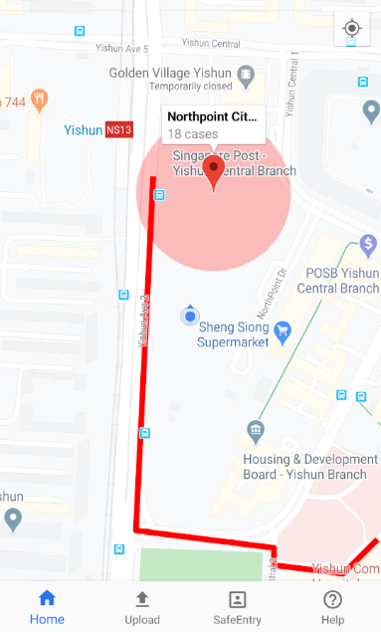
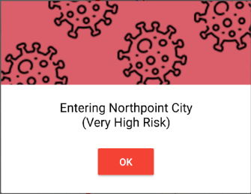
ScareAway Features
Information of the cases in that place
Geofenced Hotspot
Quick glance of information that user really want to know
Places with new cases near user are geofenced so that:
User are able to decide if they really need to go there;
Alert the user in the background when they enter any hotspot;
Discourage people to go to places with high risk unless they really need to be there.
Close Contact Trail
When user that is marked as close contact to new known cases, that user can choose to allow the app to leave a trial of their journey so people can avoid the path
Psychological Designed Alert
Designed to:
Quickly tell people the risk level they will be expose to;
Virus design to remind them of the virus to discourage stay there unnecessarily.

Slide 6
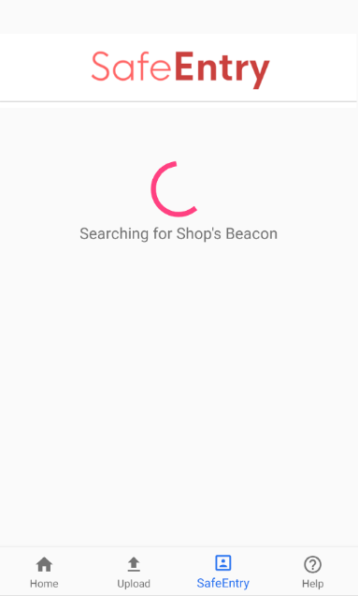
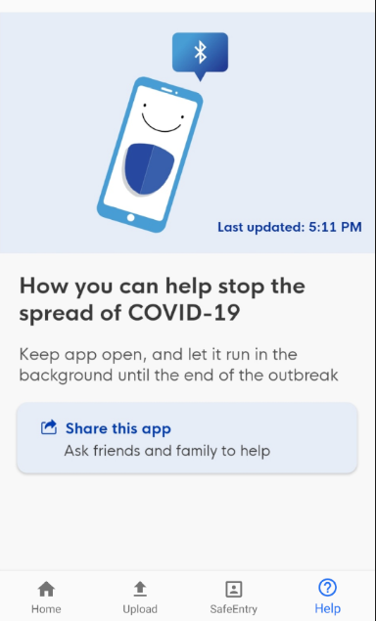
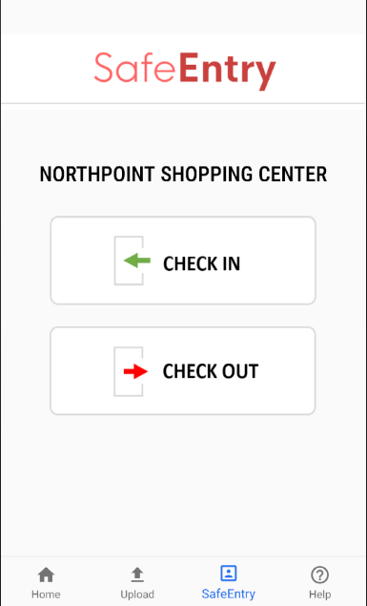
Convenience Features
Mall version TraceTogether
TraceTogether Integrated SafeEntry
Mall version of TraceTogether to:
Opens up more convenience opportunity to TraceTogether user
Add additional contact tracing point data
Will automatically pop up when the mall’s TraceTogether is found and make it a one-click check-in and out process
BLE

Slide 7
Rationale
01
Traction
Get useful features to reduce transmission rate out to large number of existing users fast.
02
Exponential Effectiveness Curve
The more users using TraceTogether, the effectiveness of contact tracing grow exponentially.
03
Easy to test
Cheap to test out if it feature will be a success or not before investing in it.
04
Highest Cost Effectiveness
With all the points above, this will be the cheapest way to achieve the highest returns, if it is a hit.

Slide 8
Testing Before Implementing
Survey
A/B Testing
Ask the existing user if it is a feature that they want
Run different ads with the different narratives and check the conversion rates
Running POC
Add sample marketing material that is to be placed on mall here
At the entry of one mall, place marketing material to see if will scan the code or go to the website to learn more.

Slide 9
THANK YOU
Insert the Subtitle of Your Presentation

